Slide 1
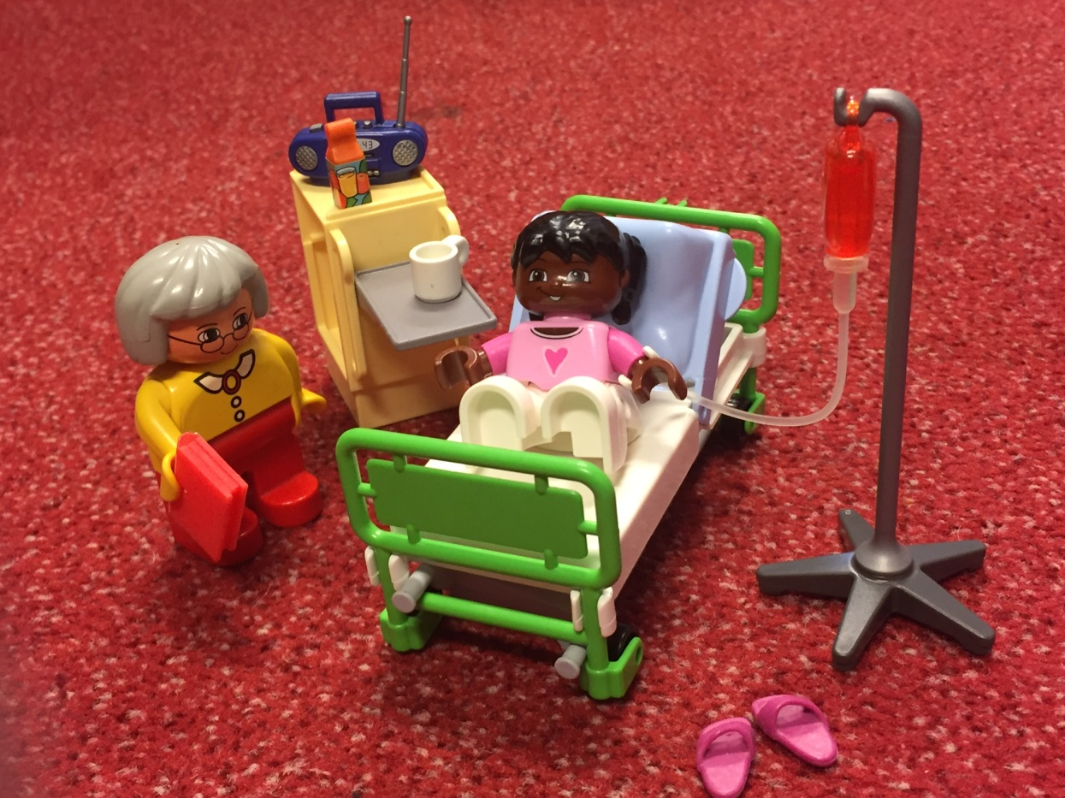
12-5-2016
Intercultural communication

Slide 2
Definition
What is culture?
The way of life, customs and ideas of a particular group of people at a particular time.
Of influence are:
- Country
- Neighbourhood
- Education
- Upbringing
- Friends
- Religion

Slide 3
Western Pyramid
Pyramids of needs
Self-actualization
Safety needs
Physiological needs
(Self) esteem
Love/Belonging needs

Slide 4
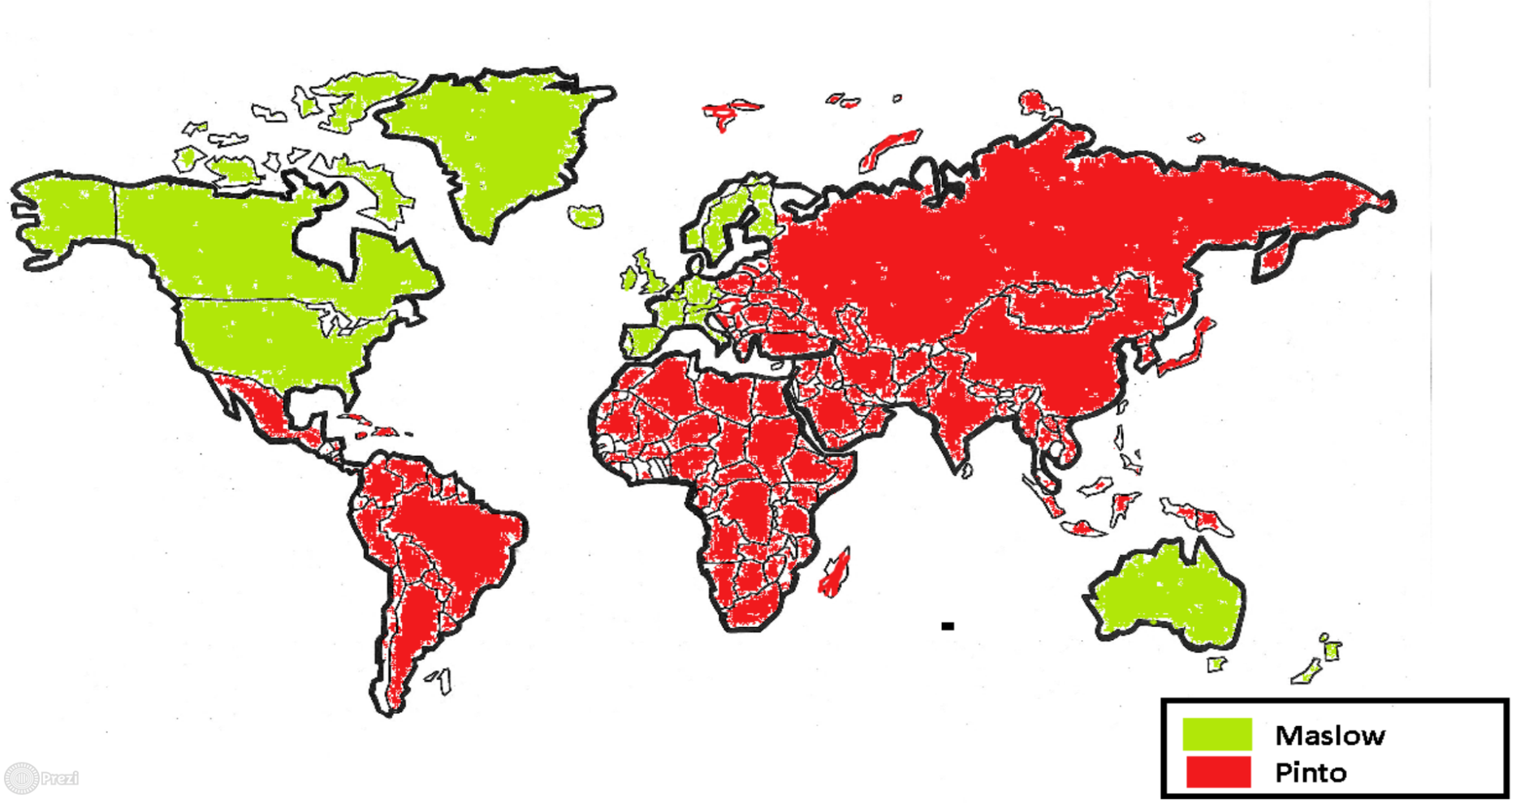
World population
Pyramids of needs
12%<->88%

Slide 5
Non Western pyramid
Pyramids of needs
Honour
Primary needs
Good name/Reputation
Needs to please

Slide 6
Values and standards of influence on communication in non western cultures
Hierarchy:
- age
- status
- education
interrelation man-woman
Respect
Politeness
Obedience
Honour, shame
Hospitality
Taboo topics
Mutuality

Slide 7
Communication problems due to cultural differences
Communication problems
Language
Values
Customs
Non verbal codes
World vision
Social relations
Notes:
.

Slide 8
Indirect communication in order to prevent disgrace
Small talk
Talking on behalf of fictional third person
Use of proverbs
Use of non verbal codes
Use of metaphors
Use of stories

Slide 9
Tools
Interest
Curiosity
Attention
Flexibility
Boldness
Let differences be, acknowledge the other
Ask for help

Slide 10
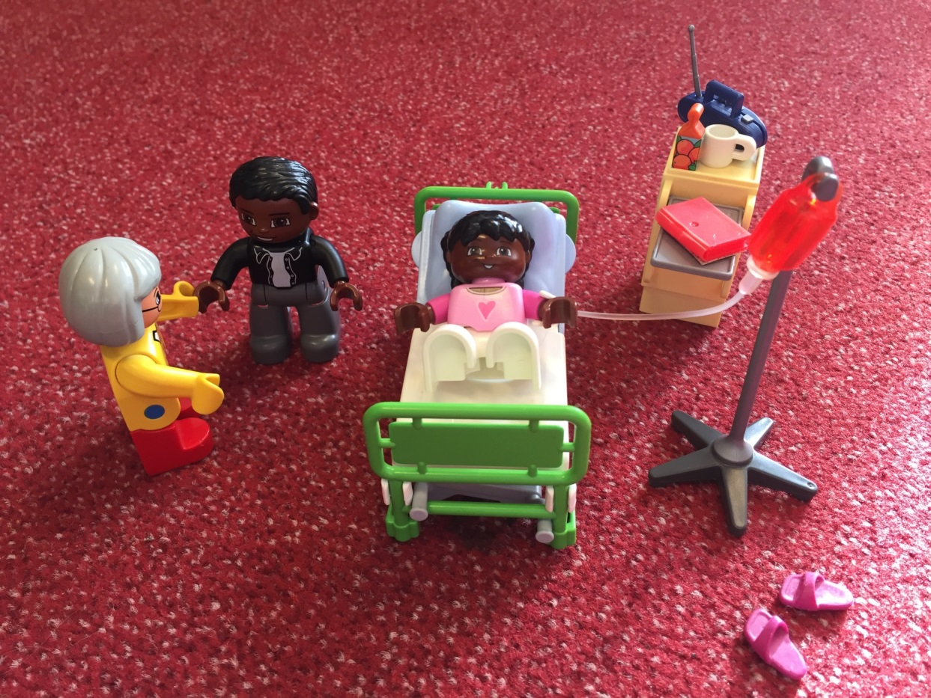
Make the difference!

