Slide 1


The relevance of the cultural/linguistic background of families with regard to the medical management of their children with cancer
Andishe Attarbaschi
10th HOPE Congress in Vienna, 10th – 13th May 2016

Slide 2
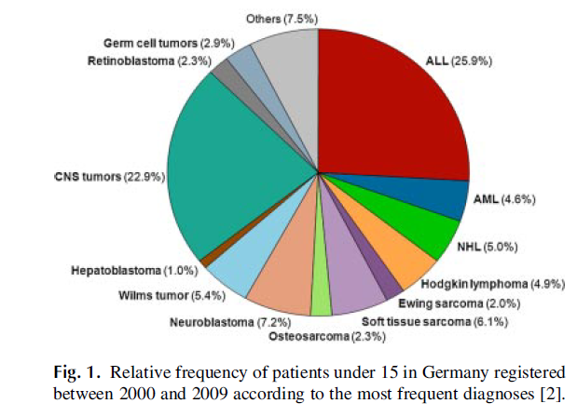
Cancer in children and adolescents
● incidence: 16 cases / 100.000 children <15 years of age
● male to female ratio: 1,1
● age at diagnosis: 50% of pts. <5 years of age
● most frequent cancers:
1. leukemias
2. brain tumors
3. lymphomas

Slide 3
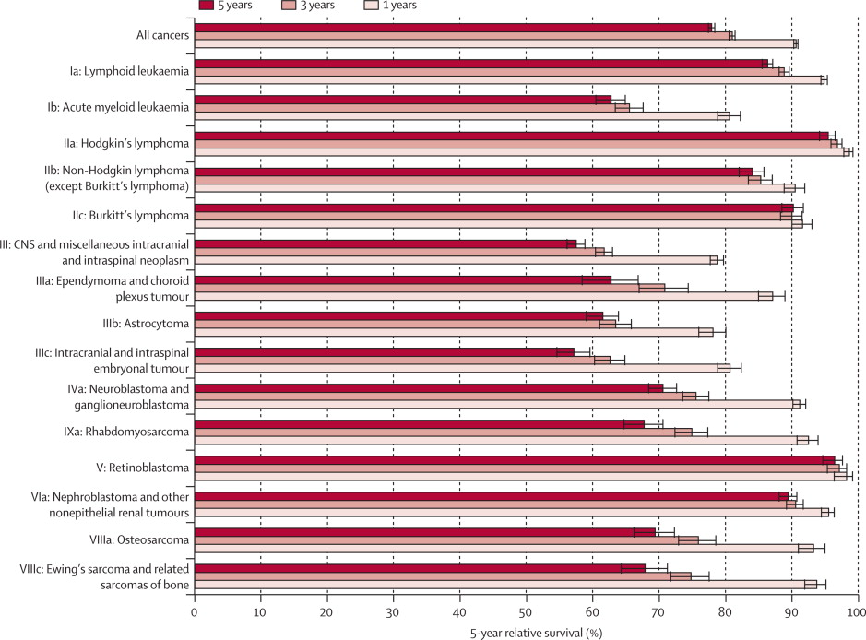
Cancer in children and adolescents
● survival rates in children <15 years of age with cancer ●

Slide 4
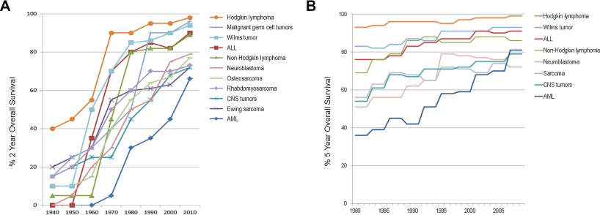
Cancer in children and adolescents
● development of survival rates in children with cancer ●

Slide 5
St. Anna Children‘s Hospital – Vienna
● admittance of 100–110 pts. with cancer per year!
● 35–40 pts. undergo allogeneic stem cell transplantation
per year!
● 30–50% of patients and families have a migration
background and limited German proficiency!
● most families are from Turkey, Ex-Yugoslavia, Ex-USSR,
Eastern Europe and increasingly from the near east
region!

Slide 6
Language barriers in pediatric oncology
● number of people with limited German proficiency in
Austria is around 9–10% of the total population.
→ number of people “linguistically isolated” unclear?
→ providing respectful and effective medical care across
language and culture is challenging!
→ language barriers between clinicians and patients or
families have been associated with misdiagnoses,
inappropriate treatment, patient and family
dissatisfaction, the need for repeat visits, and other
time-consuming and costly outcomes!

Slide 7
Language barriers in pediatric oncology
● number of people with limited German proficiency in
Austria is around 9–10% of the total population.
→ lack of informed consent forms in other than the
country‘s official language
→ lack of compliance concerning oral medication,
nutritutional recommendations, and hygienic
measures in the out-patient setting (at home)
→ parents feel ashamed not to have understood the
physicians and do not ask for repeat clarification

Slide 8
Language barriers in pediatric oncology
● Clinicians ● Nurses
● Parents and patients ● Psychologists, social workers
● Physiotherapists, art therapists, music therapists
● Kindergarden teachers, school teachers, nutrionists
and
● (qualified medical) interpreters

Slide 9
Language barriers in pediatric oncology
● diagnosis (cancer, therapy, time-line, side-effects)
● discussions with people of other disciplines
● randomizations (!)
● response assessments
● surgery, radiotherapy
● life-threatening situations
● palliation
● imminent death
● complaints, dissatisfactions, etc.
● end of therapy

Slide 10
Social barriers in pediatric oncology
● handshaking: sign of respect in western countries, but sometimes
rejected by other cultures
● different ideas why the child developed which type of cancer
(“gender of cancer of prognostic importance!”)
● sometimes fathers wish to spare the mother and child from
the diagnosis at all or the severity of the medical situation
● different manners how to deal with a dying child
● sometimes families wish that all decisions are discussed with
other specialised pediatric hemato-oncologic institutions

Slide 11
Social barriers in pediatric oncology
● different acceptance of female and male physicians
● interestingly, religious parents/families are more easily
managed than atheistic ones, because the former usually
believe in the physicians and god to take good care for their
child with cancer
● our attitude to be completely honest, from the first to the
last minute of taking care for a child with cancer is not
always acknowledged, but rather interpreted as ruthlessness
and heartlessness

Slide 12
Social barriers in pediatric oncology
● grief and bereavement are influenced by culture – thus, in
palliation it is important to pre-arrange everything such as
priest, anointing of the sick, transport of the lost ones to
the home country, etc.
● lack of clarity if the families have informed (insisted to
inform) their child about the illness
● family is defined differently by different cultures (i.e., godparents,
extended family members) – who is the contact person?
● offer of psychological counselling which is part of treatment, could
be offending since in some cultures this is negatively stigmatized

Slide 13
Pediatric oncologists – challenges
● choice of words and sentences
● accurate, word-for-word interpretation
● experience of oncologist and interpreter at working together
● family’s level of comfort
● conﬁdence and sense of control working with interpreters
● major obstacles of communicating by an interpreter:
→ complexity of information
→ inability to know whether information has been accurately
interpreted
→ extra time it takes to conduct interpreted discussions
‘‘I am not always convinced that my words are accurately translated, and does the family get how important or life-threatening this illness is – did the translator stress what I found important – this may alter patient understanding.’’

Slide 14
Pediatric oncologists – benefits
● beneﬁts of having an interpreter present:
several oncologists have the opinion that interpreters could
facilitate the communication process in ways other than
providing accurate and complete interpretations.
● interpreter’s knowledge of a patient/family’s culture
“The use of interpreters may actually improve communication
during this difﬁcult process as it requires the information be
understandable to the interpreter who is more likely to ask for
clariﬁcation than a family who lacks an intermediary.’’

Slide 15
Pediatrics-based interpreters
● factors affecting the ability to interpret accurately and effectively
→ length of physician’s sentences as most affecting the ability
to interpret accurately and effectively
→ perceived lack of physician sensitivity toward the impact of
sentence length, information complexity, and information
load on the interpretive process
→ physician’s knowledge of a patient/family’s culture
→ physician’s level of experience working with an interpreter
→ the physician’s use of medical terminology/jargon
“Very often physicians will speak in extremely lengthy sentences and barely pause for the interpreter to render the interpretation. Some doctors use very complex medical terminology which, even if the interpreter renders the interpretation, the patient will not understand it.’’

Slide 16
Pediatrics-based interpreters
● interpreters often give the feedback that physicians do not
understand the cultural differences or issues that may affect
communication with patients/families.
● beyond word-for-word interpreting, interpreters wish to be given
more of an opportunity to share their insights into the cultural
norms of patients/ families because they share their cultural
background and could easily gain their trust.
How should we proceed with these wishes of interpreters?
problem: since they could get too much involved in the family,
quality of interpreting could get questionable!
‘‘Many of the medical personnel have misconceptions about Turkish-speaking patients. Many of the patients are recent immigrants.....! And their knowledge of Western medicine is very limited. Their familiar methods for curing certain ailments seem very bizarre to the medical staff.....! The knowledge of basic human anatomy that these patients have is very scarce so the entire hospital visit and medical examinations may be very intimidating.”

Slide 17
Parents – challenges
● discomfort and anxiety and shame not to speak German
● when parents are asked about their reactions when they ﬁrst
found out that they would be discussing their child’s diagnosis
and treatment options with an German-speaking physician,
many say they felt ‘‘scared’’ and ‘‘worried’’ that they would not
understand what the physician has to say. Several say that they
were ‘‘concerned’’ because no one mentioned to them that an
interpreter would be provided.
● most parents report feeling ‘‘more secure,’’ ‘‘more conﬁdent,’’ or
generally ‘‘better’’ about having an interpreter present.

Slide 18
Parents – challenges
● when parents are asked to comment on their ability to
comprehend what their child’s doctor was saying, given the
presence of an interpreter, several still reported comprehension
difﬁculties related to the interpretive process or use of jargon.
They report that their interpreters often tried to clarify or
simplify what their child’s physician wanted to say to them, but
that these efforts were not always successful.
‘‘It is another language that they use in the hospital.....! I didn’t understand this because they are words in the medical language that one has never heard of. And well, there were words that they say in Turkish I didn’t understand.’’

Slide 19
Improvements
● providing parents with materials aimed at helping them
understand key medical terms and concepts in pediatric oncology
● developing strategies for reducing wait time for interpreters
● allowing clinicians to work with the same interpreters from
consultation to consultation
● interpreter’s intercultural knowledge and skills could be put to
good use in order to improve communication with parents whose
cultural as well as linguistic background is different from the
clinician’s one
‘‘If the doctor knows how to work with an interpreter then the medical jargon, length of sentences and his/her knowledge of patient’s culture become less important. If the oncologist has a high level of experience working with interpreters then that means he/she takes into account those other factors to improve communication as much as possible and is usually open to interpreter in put in relation to them.’’

Slide 20
Personal experience
● trust and respect between the patients/families and physicians/
caring team is everything!
● social conversations that help develop trust are easily lost when
there is a language barrier!
● having a dedicated interpreter helps families feel connected and
help us feel more comfortable with the information that is being
translated!
● my foreign background having parents migrated to Austria is
of big help in working with patients/families from Turkey and
near East region!

Slide 21
Thanks to Nisha Mangalath (psychologist at the St. Anna Children’s Hospital,
Department of Pediatric Hemato-Oncology) for her helpful comments!
Thank you for your attention!

